Slide 1
SWAN- SMT Profile Verify Review
JBD-VN-ME
2022/01/24

Slide 2
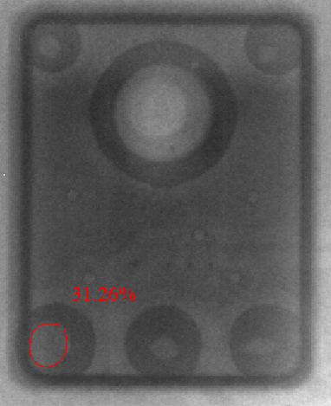
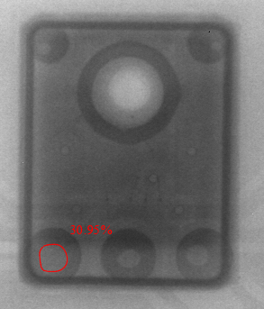
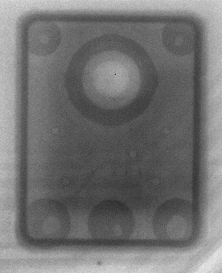
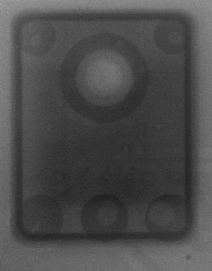
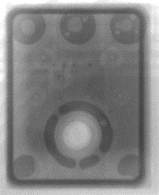
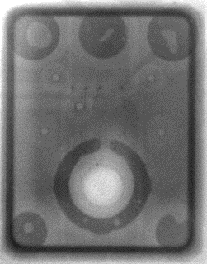
96.1516T00- MIC SMT Solder and Stencil Verify
1. Some defect Picture
Solder void defect
Solder ball defect
O-ring Issue
Summary:
- Based on this verify method, we detect a low defect rate as above.
-Some defect Picture on verify progress.

Slide 3
96.1516T00-SMT profile to optimal
2. Comparing Reflow Profile
Profile feature | Result
Ramp-up rate | 1.46~1.49
Preheat Time (150-180°C) | 76~78
Soldering time (TL>217°C) | 52~54
Peak Temperature (Tp) | 240.5~ 242.9
Time within 5°C of actual peak temperature (tp) | 25~27
Ramp-down rate | -1.38 ~ -1.32
Profile feature | Result
Ramp-up rate | 1.00~1.02
Preheat Time (150-180°C) | 78~84
Soldering time (TL>217°C) | 70~80
Peak Temperature (Tp) | 245.0~ 245.3
Time within 5°C of actual peak temperature (tp) | 27~29
Ramp-down rate | -1.13 ~ -0.91
Profile feature | Result
Ramp-up rate | 1.00~1.02
Preheat Time (150-180°C) | 78~84
Soldering time (TL>217°C) | 70~80
Peak Temperature (Tp) | 245.0~ 245.3
Time within 5°C of actual peak temperature (tp) | 27~29
Ramp-down rate | -1.13 ~ -0.91
Profile feature | Result
Ramp-up rate | 0.88~0.92
Preheat Time (150-180°C) | 94~99
Soldering time (TL>217°C) | 82~87
Peak Temperature (Tp) | 245.0~ 246.3
Time within 5°C of actual peak temperature (tp) | 26~28
Ramp-down rate | -0.91 ~ -0.82
Profile feature | Result
Ramp-up rate | 0.80~0.89
Preheat Time (150-180°C) | 90~96
Soldering time (TL>217°C) | 71~76
Peak Temperature (Tp) | 245.1~ 247.8
Time within 5°C of actual peak temperature (tp) | 26~29
Ramp-down rate | -1.15 ~ -0.92
01
02
03
04
05
1.Void solder >30%: (2.5%)
2. Solder ball: (2.5%)
3. O-ring not seal: (2.0%)
1.Void solder >30%: (1.0%)
2. Solder ball: (2.0%)
3. O-ring not seal: (2.5%)
1.Void solder >30%: (1.0%)
2. Solder ball: (1.0%)
3. O-ring not seal: (0.0%)
1.Void solder >30%: (1.0%)
2. Solder ball:(1.25%)
3. O-ring not seal:(0.0%)
1.Void solder >30%: (0.75%)
2. Solder ball: (1.25%)
3. O-ring not seal: (0.0%)
The first optimal
Stencil 0.09 mm
Stencil 0.10 mm
Stencil 0.10 mm
Stencil 0.10 mm
Summary: Void Solder >30% and Solder ball unable to improved 100%.Fii RD&ME will keep and monitor this issue.

Slide 4
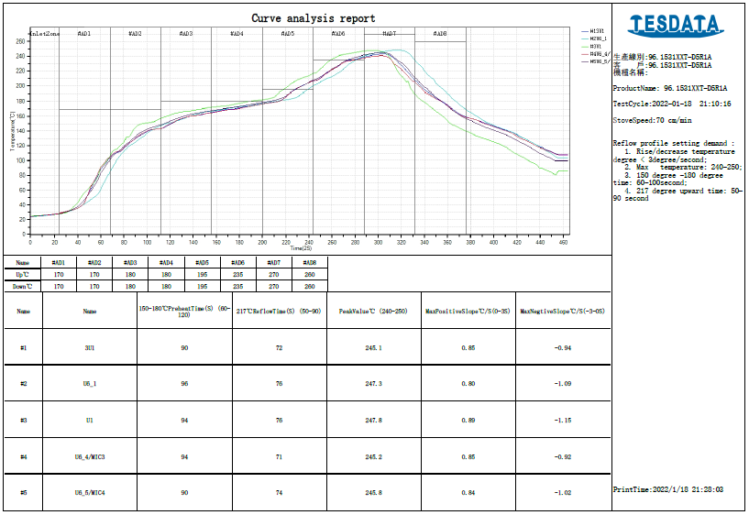
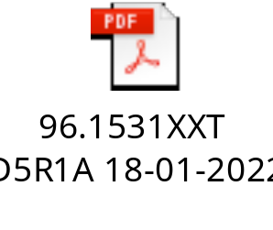
96.1516T00-SMT profile to optimal
2.Reflow Profile optimal
Status | Mass Product Stencil 0.10 mm (100pcs)
 | Fail Q'Ty | Total | Defect rate
Void solder >30% | 3 | 400 | 0.75%
Solder ball | 5 | 400 | 1.25%
O-ring not seal | 0 | 400 | 0.00%
Summary: Void Solder > 30% unable to improved 100%. Fii RD&ME will keep and monitor this issue.

Slide 5
Next plan: Optimal #06

Slide 6
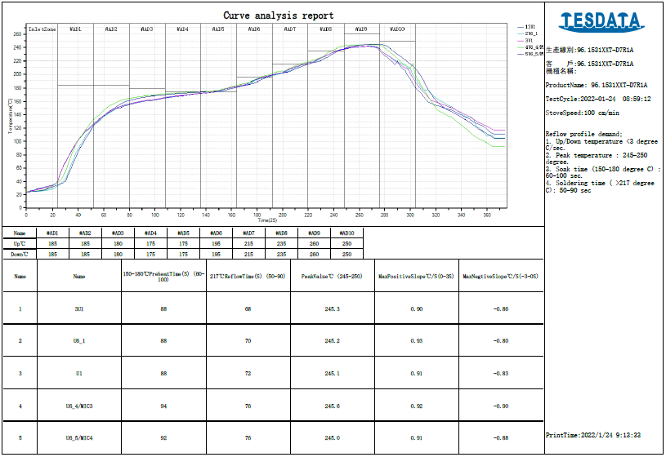
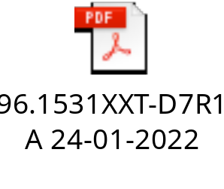
96.1516T00-SMT profile to optimal
2.Reflow Profile optimal
Status | Mass Product Stencil 0.10 mm (100pcs)
 | Fail Q'Ty | Total | Defect rate
Void solder >30% | 3 | 160 | 1.88%
Solder ball | 2 | 160 | 1.25%
O-ring not seal | 0 | 160 | 0.00%
Summary: Void Solder > 30% unable to improved 100%. Fii RD&ME will keep and monitor this issue.

